Slide 1

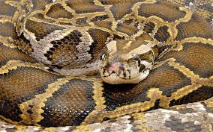
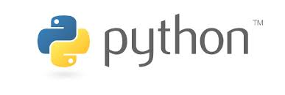
Python
(The programming language not the snake)

Slide 2
Python is...
A High Level Language
Interpreted
Dynamically Typed
Extensible
Widely Used

Slide 3
High Level Language
Low level (C, C++, Fortran)
  Manage memory and machine level tasks yourself variables are machine types
  Won't stop you from doing dangerous things
  Faster to execute slower to write and debug
High Level (Python, IDL)
  Deal with more idealized data types
  No direct handling of memory allocation or other machine level stuff
  Will stop you from doing really dangerous stuff
  Faster to write and debug slower to execute

Slide 4
Interpeted
● Interpreted (Python, IDL)
– Runs the code on the fly
– No setup time but slower execution
– Smaller program file size
– “Obvious” errors will not be found until runtime but code can execute correctly even with errors
● Compiled (C++, Fortran)
– Creates machine instructions from the code == “compiling”
– Have to wait for your code to compile but it executes more quickly – Many errors found at compile time

Slide 5

Dynamically Typed
Statically Typed
  int x = 3
  Type is evaluate prior to running
  Variables are fixed
  x = “hello” ERROR
Dynamically Typed
  x = 3
  Type is evaluated on run
  Variables can change at any time
  x = “hello”

Slide 6
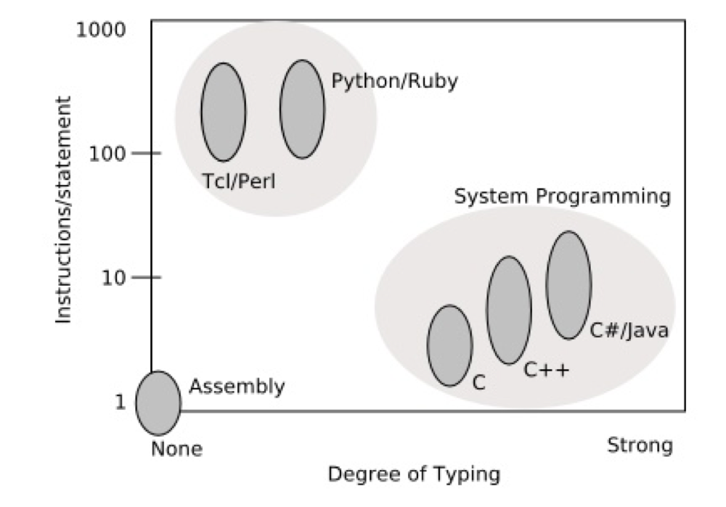
Run Summary

Slide 7
Extensible
You can easily extent python to use c and fortran code for when you need to have fast execution speed.

Slide 8
Widely Used
Free
Open Source (though not exclusively)
Used in :
  Web development
  Game development
  Data Analysis
  Science : Astronomy, Geophysics, Biology, etc.
  And more

